Slide 1
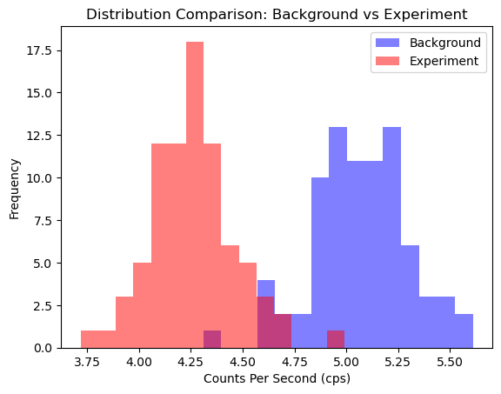
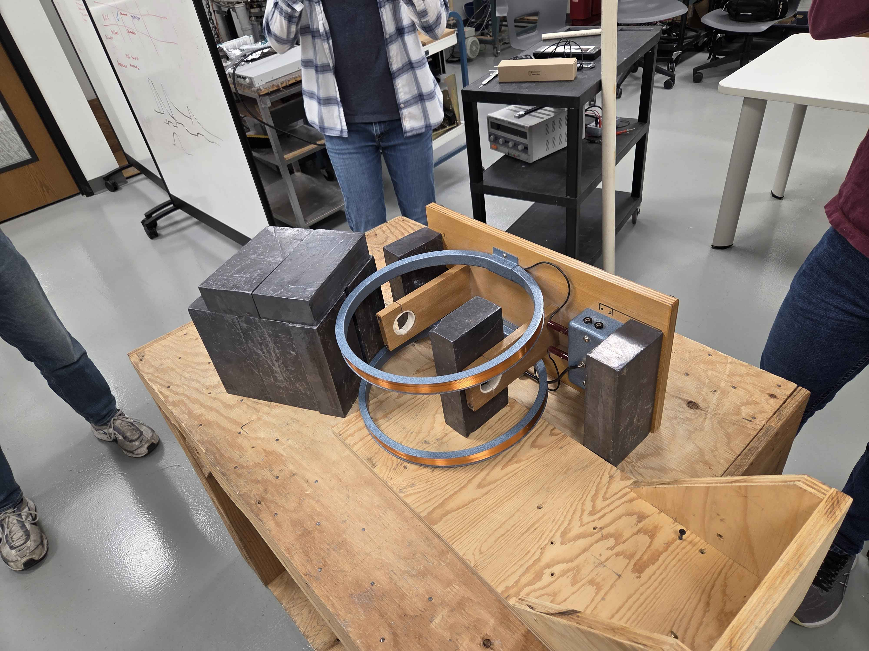
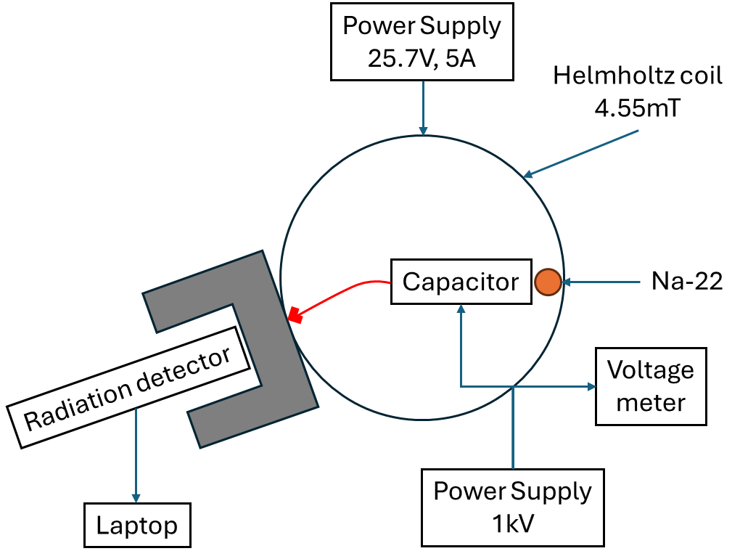
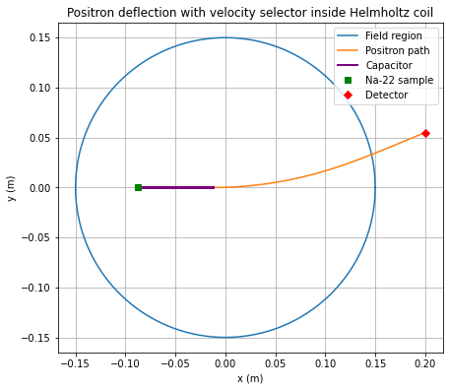
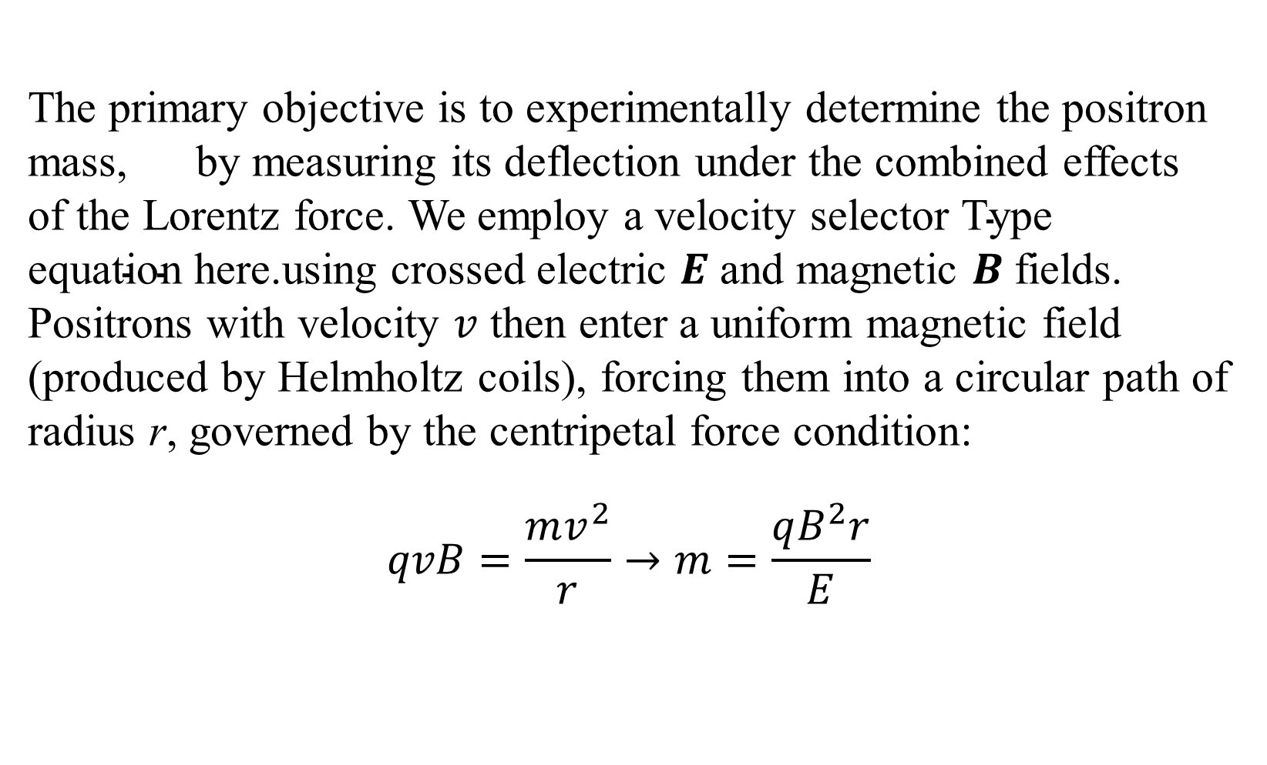
Measuring the Mass of a Positron via Magnetic Deflection
PH 336 – Advanced Physics Lab
Jarom Peterson, Makelle Forson, James Winder,
Chase Etter, Miles Bethel
Background
Results
This experiment verifies the mass of the positron by analyzing its trajectory within a controlled electromagnetic field. The positron, the antimatter counterpart to the electron, undergoes deflection when subjected to the Lorentz force. By using a Helmholtz coil in conjunction with a capacitor, we create a velocity selector that isolates positrons moving at a specific velocity. Once these particles exit the selector, the magnetic field induces a circular path with a radius proportional to the particle's momentum.
Initial results revealed a P-Value of 4.4 E -53, indicating a near-zero percent chance that the 2 datasets overlap and rejecting the null hypothesis
The primary objective is to experimentally determine the positron mass, by measuring its deflection under the combined effects of the Lorentz force. We employ a velocity selector using crossed electric $E$ and magnetic $B$fields. Positrons with velocity $v$ then enter a uniform magnetic field (produced by Helmholtz coils), forcing them into a circular path of radius r, governed by the centripetal force condition:
$$qvB=\frac{mv^{2}}{r}→m=\frac{qB^{2}r}{E}$$
Objective/Theory
Design/Method
The Na-22 sample emits positrons which will immediately undergo a Lorentz force from the Helmholtz coil generating a 4.55mT magnetic field. To select the desired positron velocities, we passed them through a parallel plate capacitor with a separation
distance of 1 mm and a supplied voltage of ~1kV from a power supply. Positrons with a velocity of ~200keV were selected. Once the particle exited the capacitor, the Lorentz force causes the positron to deflect. Using Python, we calculated the radius of deflection and offset by which the positrons would exit the coil at ~3.09cm. The Radiacode radiation detector was placed there with lead bricks in a “brick oven” fashion to act as shielding. A background measurement was taken with the sample in place and the coil/capacitor off. Experimental data was recorded and saved to a csv file
Discussion/Conclusions
References
Authors
Griffiths, D. J. (1999). Introduction to electrodynamics (3rd ed.). Prentice Hall
Jarom Peterson, Makelle Forson, James Winder,
Chase Etter, Miles Bethel

